Slide 1
The Dalles Dam Birds
Bob Cordie
Inland Avian Workshop
November 2015

Slide 2
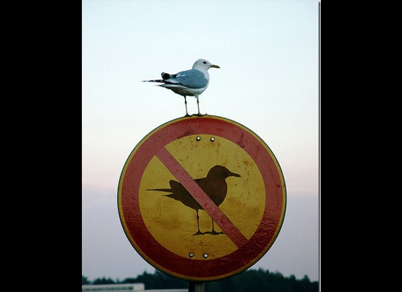
Bird of Concern
Notes:
All gulls – no mergansers cormorants during juv season, terns like other inland projects

Slide 3
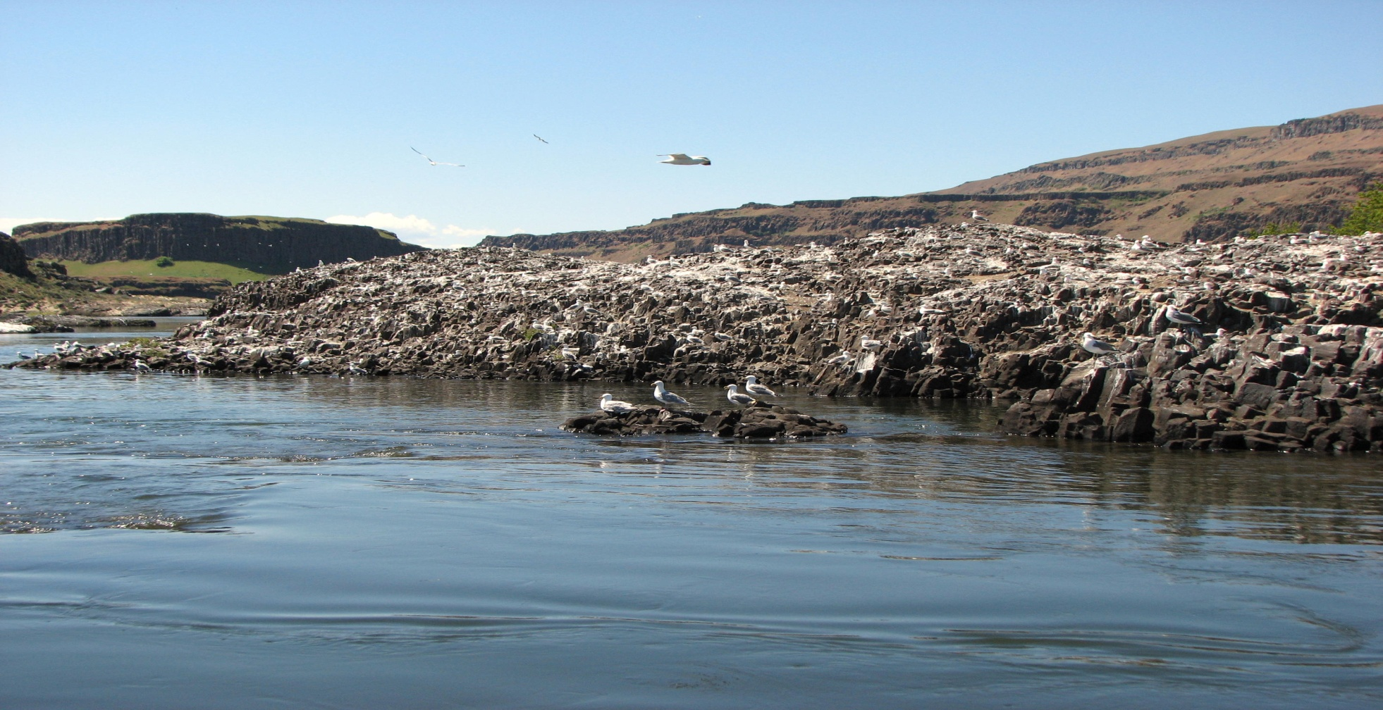
Miller Island Gull Colony
Notes:
Gull factory

Slide 4
BiOp Requirements
Juvenile survival 96% spring / 93% summer
Reasonable and Prudent Alternatives (RPAs)
  47 Manage avian predators on COE land
  48 Continue deterrent measures
  68 Monitor avian predation and smolt impacts

Slide 5
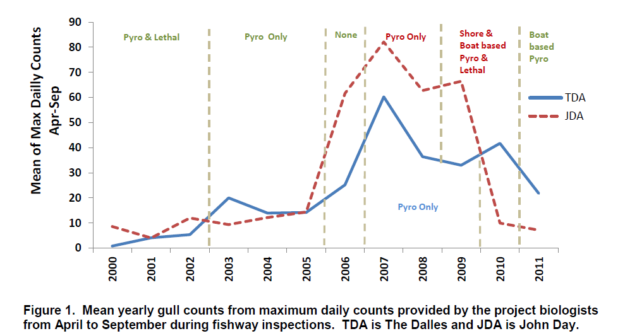
History of Gull Management
Notes:
F 2000 data start. ‘02 NEPA-NWW EA. ‘06 abatement definition difference. ‘09 new lines/more hazing/lethal for study only. ‘11 high flow. ‘12 data being processed, expect to come up slightly. Future management being debated, lack funding, performance testing….

Slide 6
Notes:
‘11 high flow year. Continued increase.

Slide 7
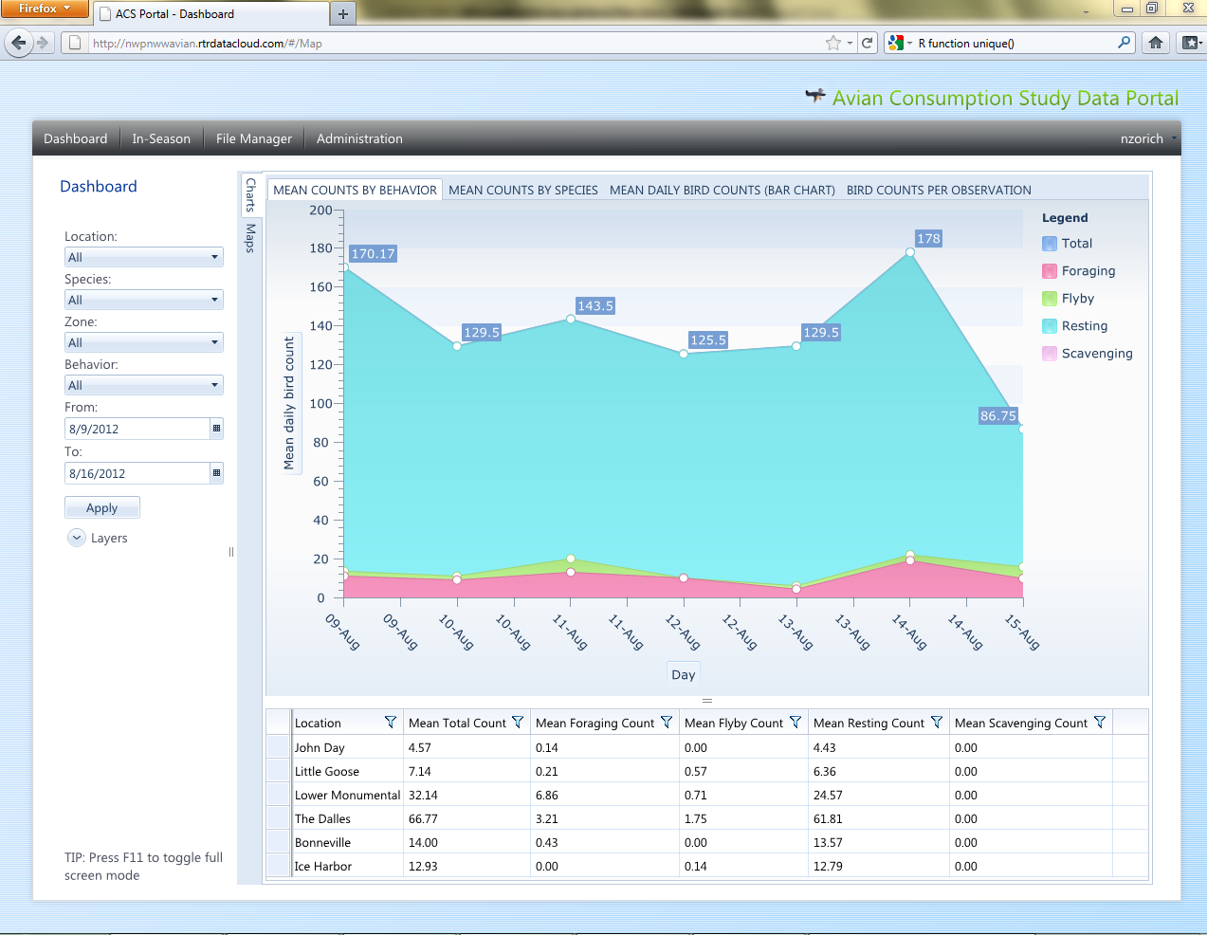
Realtime Database
Notes:
2012 monitor efforts

Slide 8
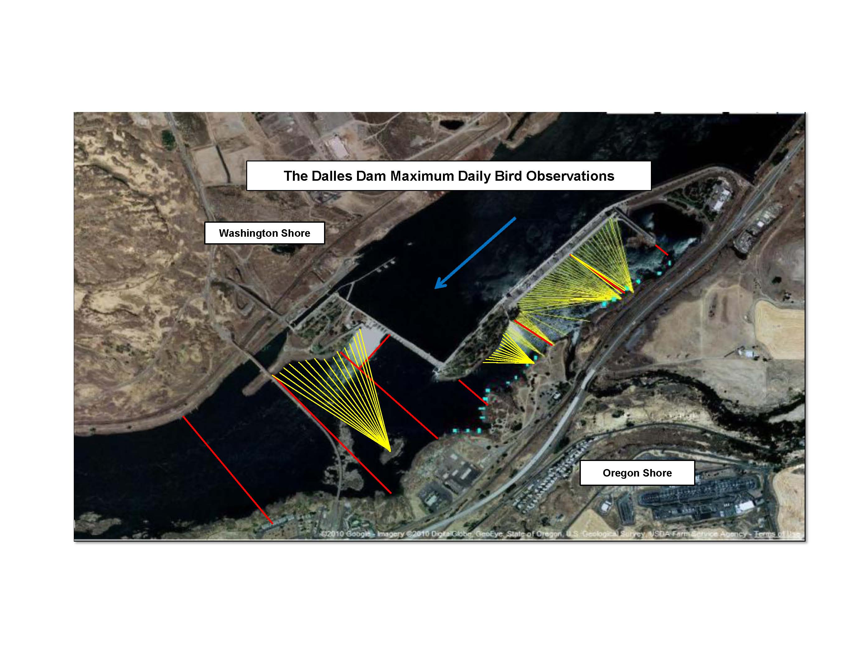
Avian Line Array
Notes:
Peninsula hazing below bridge. Lines above bridge, but ineffective during low flow. Boat hazing next season.

Slide 9
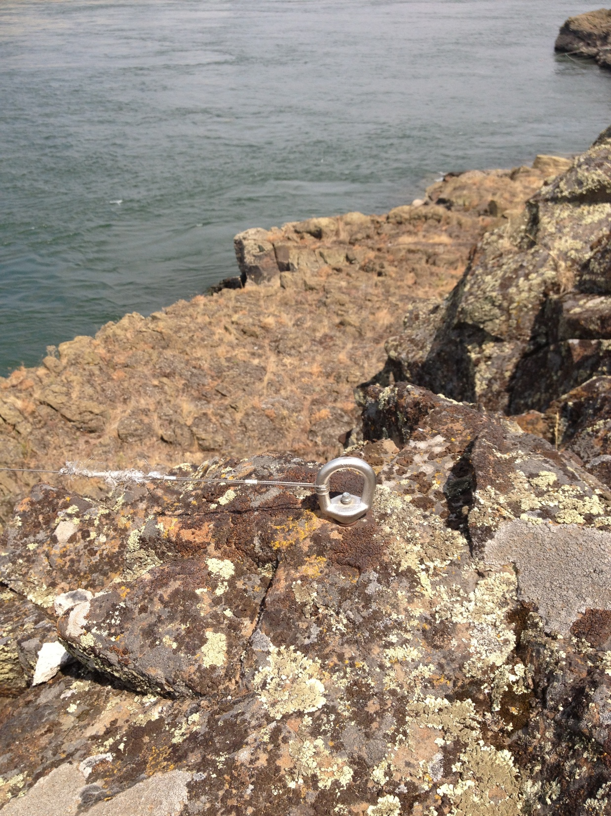
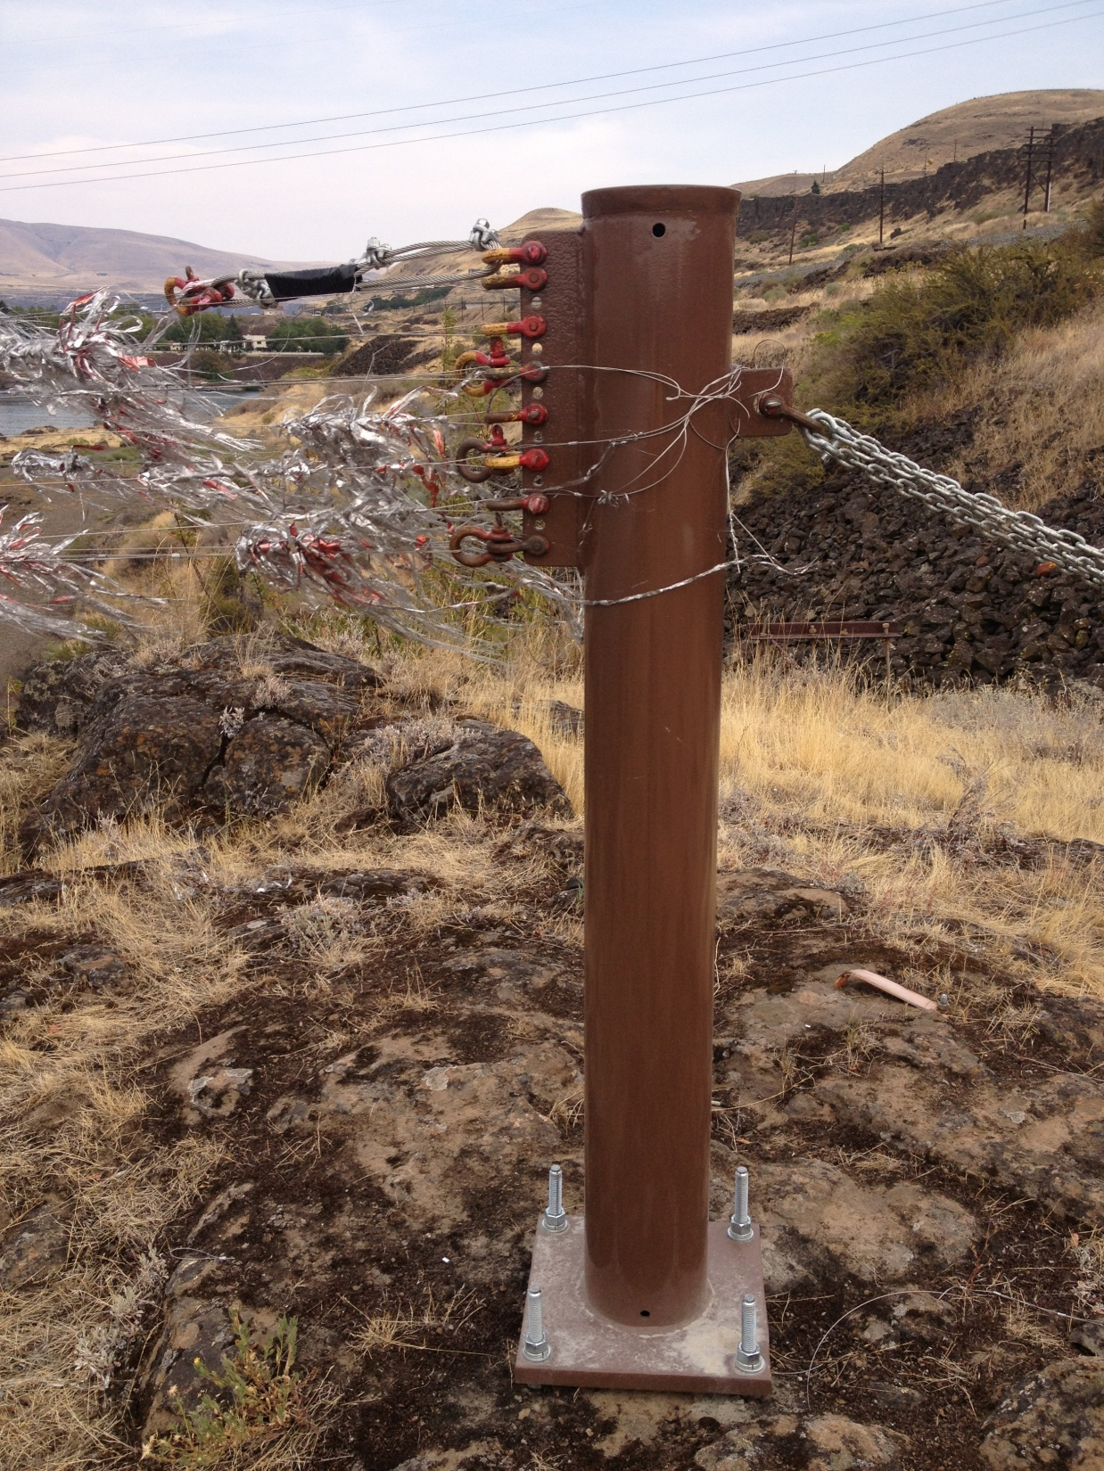
Avian Line Attachment

Slide 10
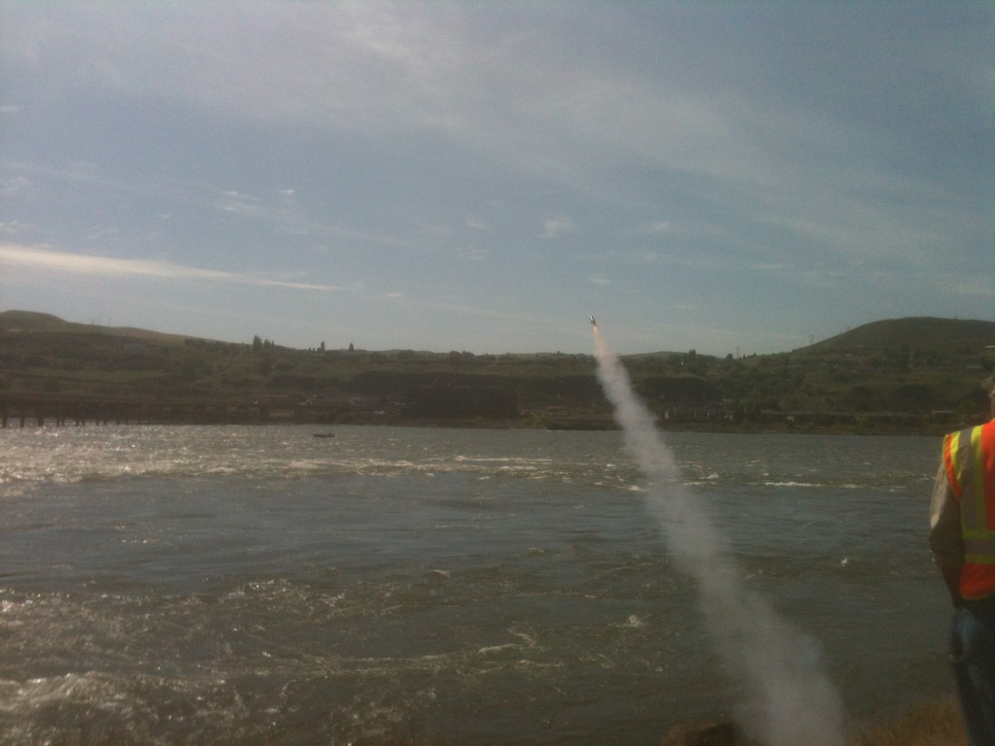
Notes:
Hazing effort

Slide 11
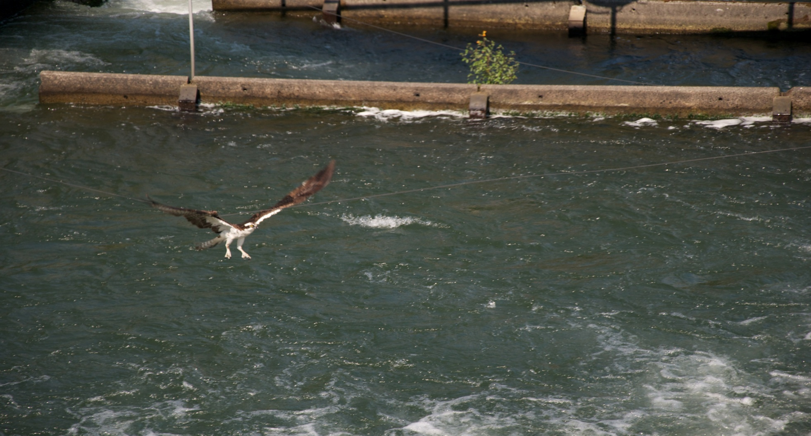
Raptor / Line Contact
Notes:
Bonn pic. Never documented at TD. Hypothesis – they can see all lines. Concern still exists. Concern not new…Falcon concern 90s, spill/lines -delisted. Decided a closer look was needed.

Slide 12
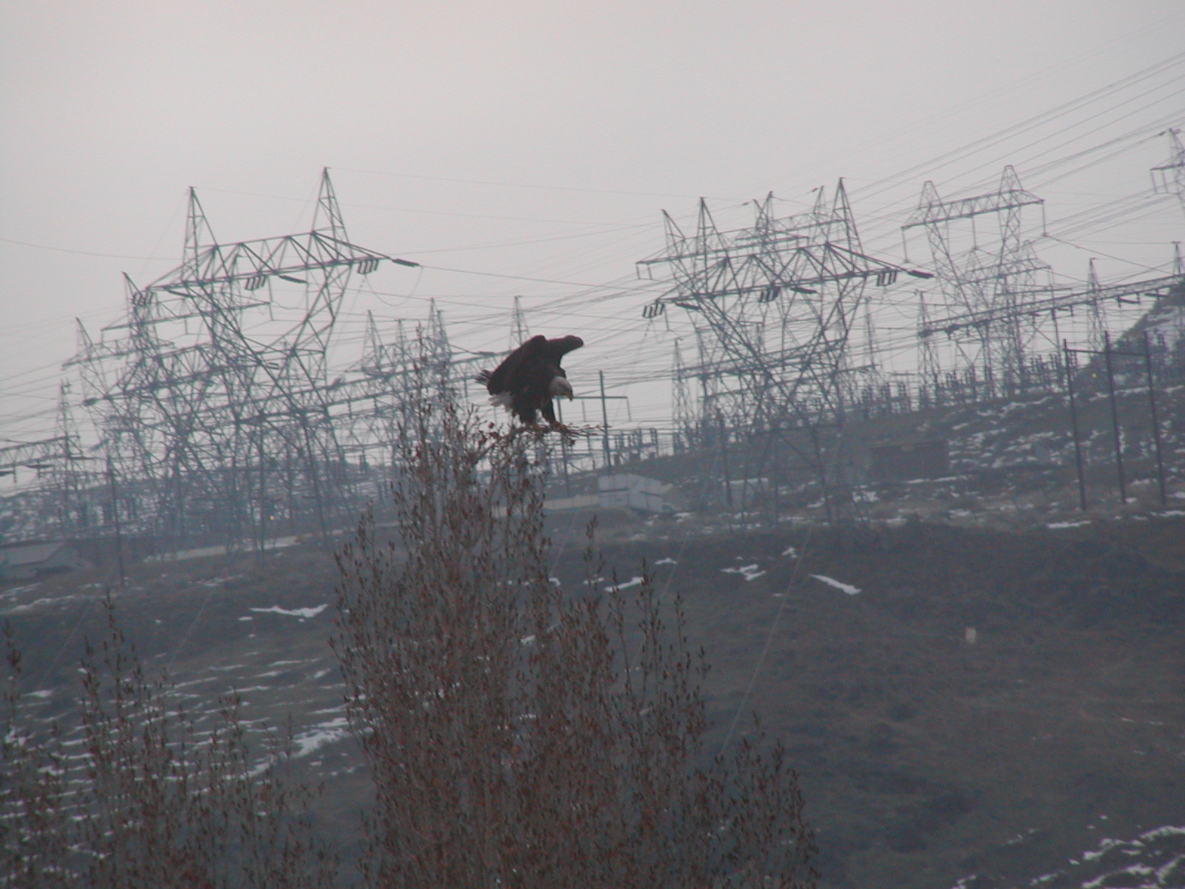
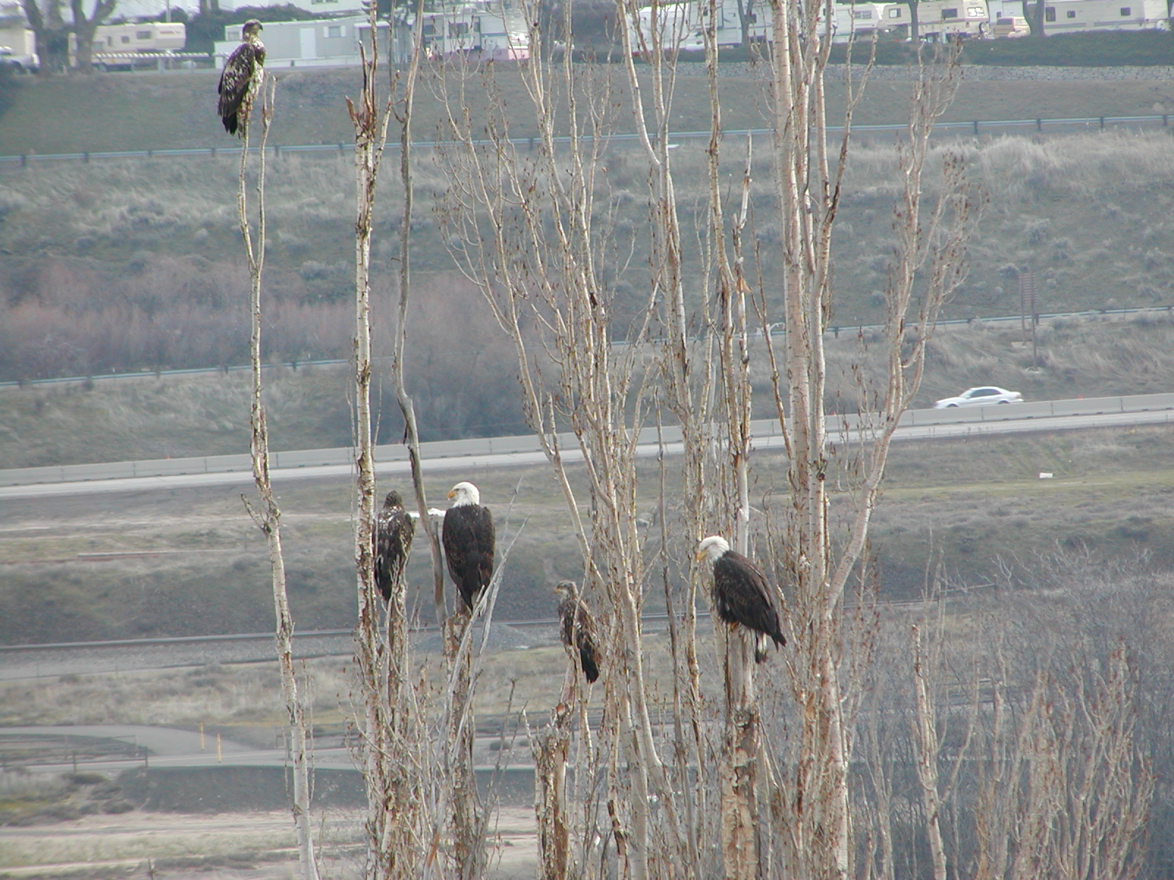
Westrick Park Eagles
Notes:
Shift to eagles. Normally few 20yrs ago. Now up to 45. Coincides with delisting. Public awareness growing seufert.

Slide 13
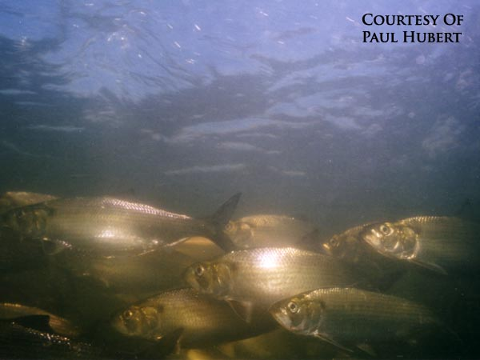
Eagle Food Source
Notes:
3million/yr. Spawn reserviors. Wimpy fish. Winter no spill. Likely most sluiceway passage.

Slide 14
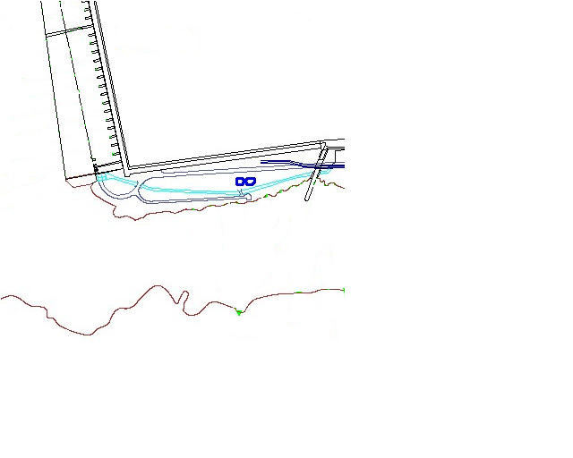
Forebay
Westrick Park
PH 3
OREGON
Notes:
FFU assisted - Eagle observation ’12 ~130hrs observations. Avoid lines. No contact. No flinches. Study again ‘13. Conclusion so far - No new lines unless removable in winter.

Slide 15
2016
USDA shore/boat hazing Apr 15 – July 30
No avian line change
Monitor all bird numbers for status reporting
Notes:
Add boat 10k/month. One month worth.

